Slide 1
St. Clair Superior & Hough Zoning Change
April 2026

Slide 2
Growth that Starts with Residents
Modern Zoning Changes

Slide 3
Cleveland does not need to be discovered; it needs to be invested in.

Slide 4
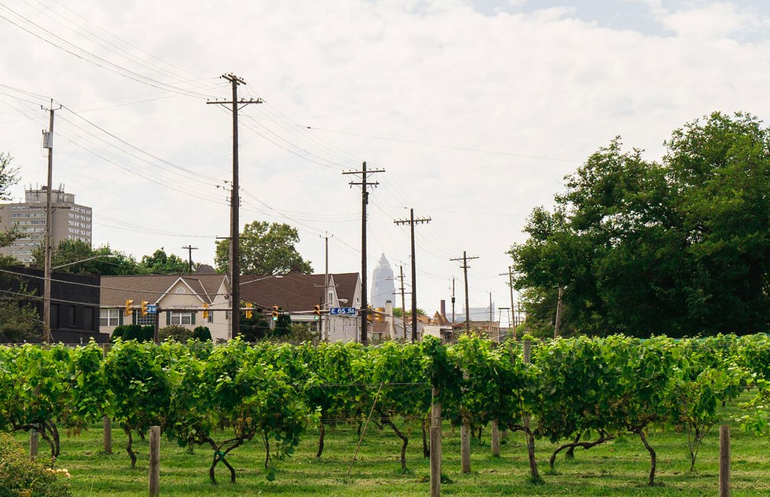
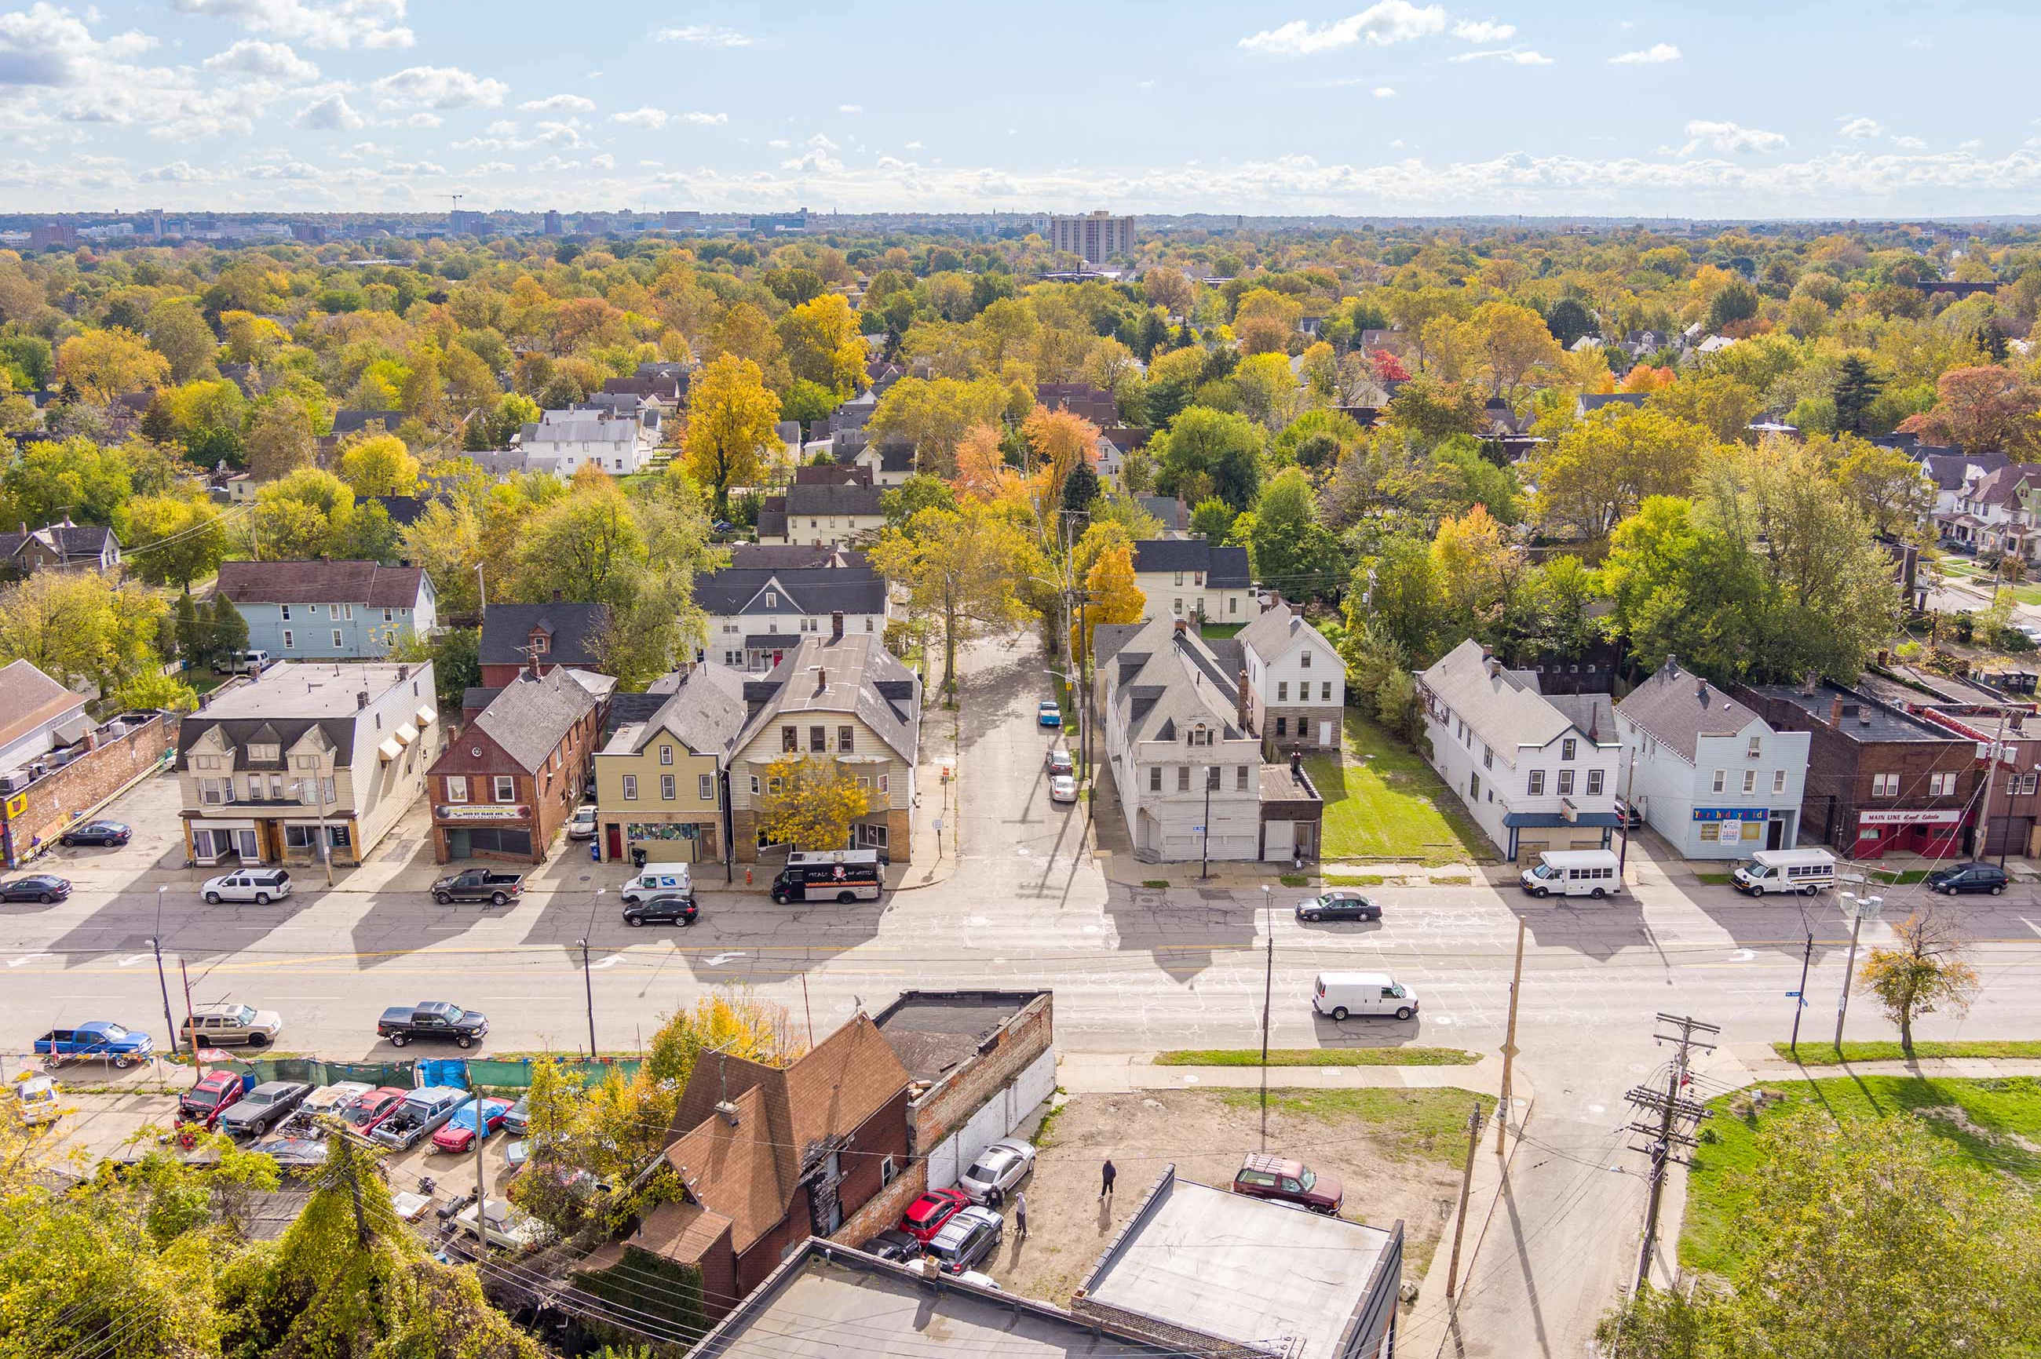
St. Clair Superior & Hough Zoning Change
For generations, residents in the Hough and St. Clair-Superior neighborhoods have carried the strength, culture, and identity of this city forward, often without the level of investment they deserved.
To better reflect what Clevelanders want to see in their neighborhoods, the City is updating its zoning code using a form-based approach.

Slide 5
Cleveland is facing a housing shortage, but solving it is not just about adding units.
St. Clair Superior & Hough Zoning Change
We must make neighborhoods stronger for the people who live in them today.
The Housing Innovation District is a commitment:
To improve the infrastructure they rely on
To strengthen the neighborhoods they love
And to ensure they directly benefit from Cleveland’s growth

Slide 6
Why Here? Why Now?
St. Clair Supeior & Hough Zoning Change

Slide 7

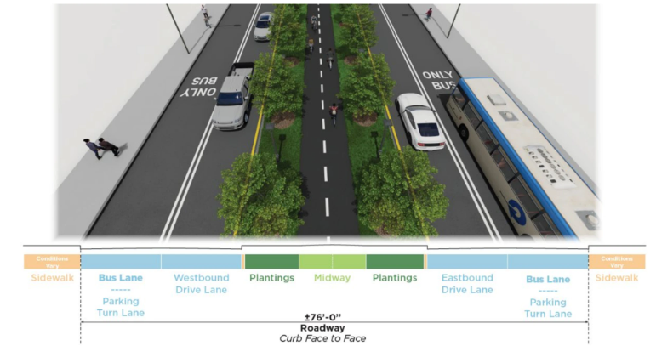
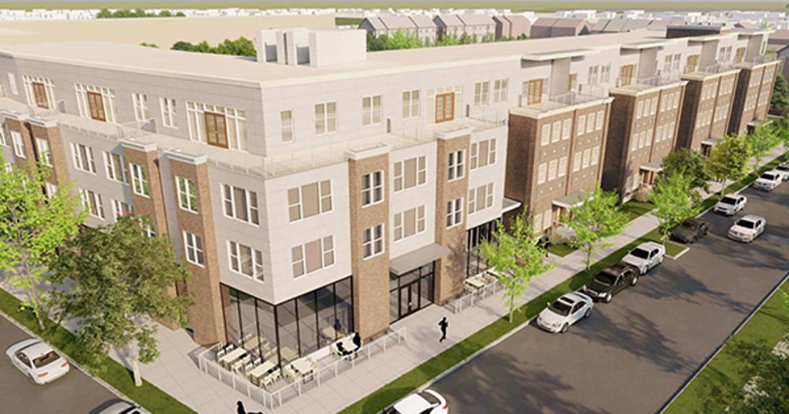
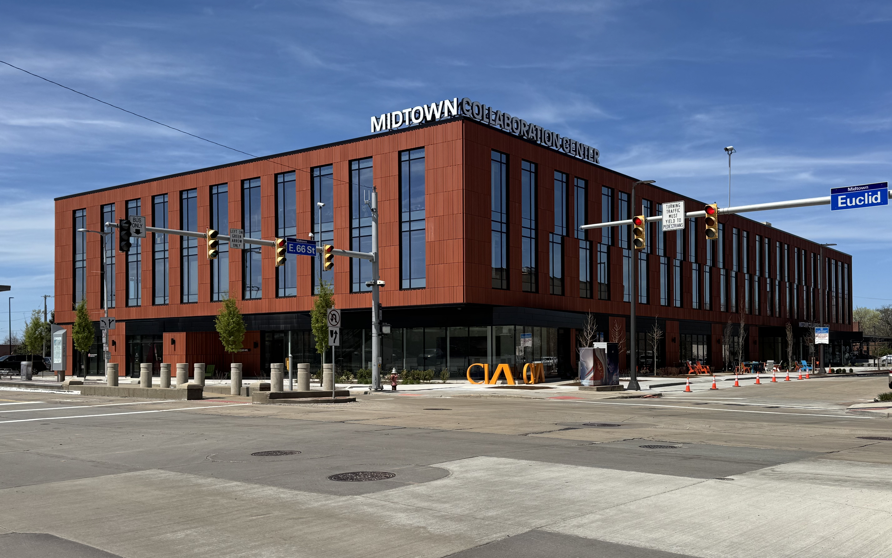
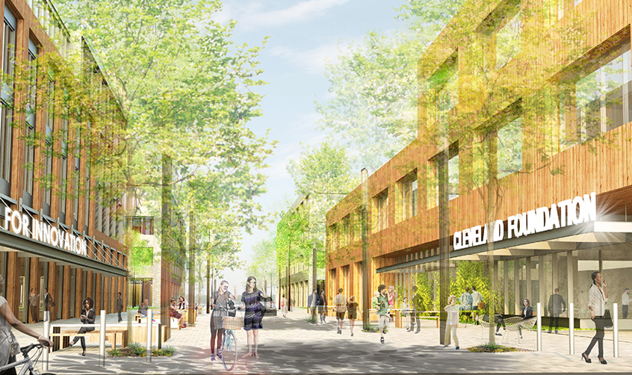
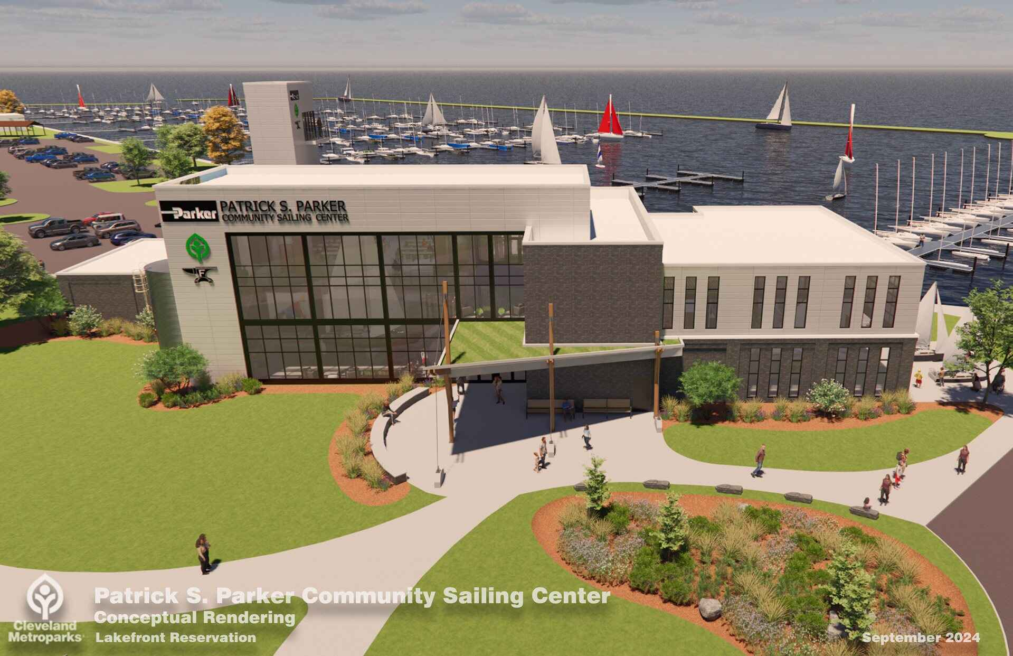
The momentum is already happening.
St. Clair Superior & Hough Zoning Change
CHEERS
CLEVELAND MIDWAY
MLK JR. SITE
MIDTOWN COLLAB
E.66TH ST
SAILING CENTER

Slide 8
Modern Zoning Through Form-Based Code
Today, Cleveland’s zoning primarily focuses on how buildings are used—like residential, commercial, or industrial—and applies similar rules across different areas of the city. But our neighborhoods aren’t all the same. Each one has its own character, history, and needs.
Form-based code shifts the focus from how buildings are used to how they look, feel, and fit within a neighborhood. This approach allows for more flexibility while ensuring new development matches the scale and design of the surrounding community. It also helps expand equitable options for housing and transportation, so every neighborhood can grow in a way that works for the people who live there.
The City has already piloted this in parts of the Hough neighborhood – the proposal is an expansion of this effort north to St. Clair Avenue.

Slide 9
Modern Zoning Through Form-Based Code
Insert Hough FBC Map

Slide 10
St. Clair Superior & Hough Zoning Change
Modern Zoning Through Form-Based Code
This is about giving Cleveland the tools to grow with intention, so every neighborhood can evolve in a way that reflects its character, supports its residents, and attracts the investment it deserves.

Slide 11
St. Clair Superior & Hough Zoning Change
Modern Zoning Through Form-Based Code
Current Neighborhood Challenges & Form-Based Code Solutions:
Walkability & Safety
Current zoning: Separates land uses, which can lead to sprawl and make it harder to access everyday amenities and jobs without a car.
FBC: Encourages a mix of uses along commercial corridors, making it easier to walk to shops, services, and job opportunities.

Slide 12
St. Clair Superior & Hough Zoning Change
Modern Zoning Through Form-Based Code
Current Neighborhood Challenges & Form-Based Code Solutions:
Affordability & Inclusivity
Current zoning: Limits housing supply and can fall out of step with demand due to complex, restrictive regulations.
FBC: Expands the range of housing options for different incomes and life stages, while ensuring new development fits the character of the neighborhood.
Current zoning: Restricts many home-based and small-scale businesses, creating barriers for blue-collar entrepreneurs.
FBC: Supports a wider range of building types and uses, making it easier for small businesses to start, grow, and thrive within their communities.

Slide 13
St. Clair Superior & Hough Zoning Change
Modern Zoning Through Form-Based Code
Current Neighborhood Challenges & Form-Based Code Solutions:
Streamlined Administrative Process & User Friendly
Current zoning: Lacks a clear, consistent permit process, making applications difficult for both staff and the public to navigate.
FBC: Establishes a clear, modern application and permitting process that reflects how development works today.
Current zoning: Text-heavy and difficult to interpret, making regulations hard to understand and apply.
FBC: Uses clear language and visual standards, making the code easier to navigate, understand, and use.

Slide 14
St. Clair Superior & Hough Zoning Change
Modern Zoning Through Form-Based Code
Form-based code makes it easier for residents to invest in their homes, attracts new housing and local businesses, and removes barriers so good projects can move forward faster.
What This Means as Examples:
A vacant storefront can more easily become a café or small business
A homeowner can add a unit for family or rental income
New housing can be built that fits the scale of the block
Mixed-use corridors can support shops, services, and jobs within walking distance

Slide 15
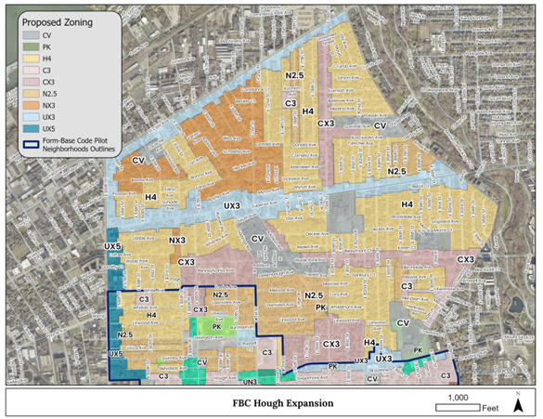
St. Clair Superior & Hough Zoning Change

